Slide 1


Navigating Change
Without Losing Hope
Bishop Ken Howell
Bishop of Toowoomba

Slide 2
Catholic schools in Queensland now lead in a context unlike any other in their 200‑year history. Students lived experiences, evolving parental expectations, workforce pressures, and shifting cultural narratives all challenge long‑held assumptions about schooling, faith, and belonging. In this environment, Catholic school leaders are called not simply to manage change, but to lead with clarity of purpose and renewed hope.

Slide 3
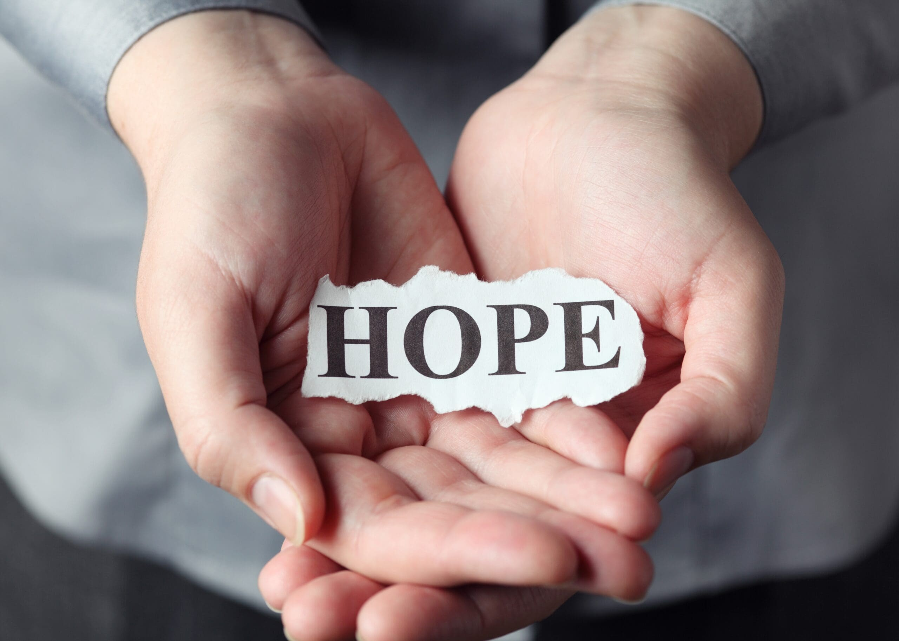
Hope Does Not Disappoint
Romans 5:5

Slide 4

Welcoming and Inclusive Communities

Slide 5
Today’s societies are characterised by a multicultural and multireligious composition. In this context, “Education contains a central challenge for the future: to allow various cultural expressions to co-exist and to promote dialogue so as to foster a peaceful society”. The history of Catholic schools is characterised by welcoming pupils from different cultural backgrounds and religious affiliations. In this context, “what is required is courageous and innovative fidelity to one’s own pedagogical vision”, which is expressed in the capacity to bear witness, to know and to dialogue with diversity.

Slide 6
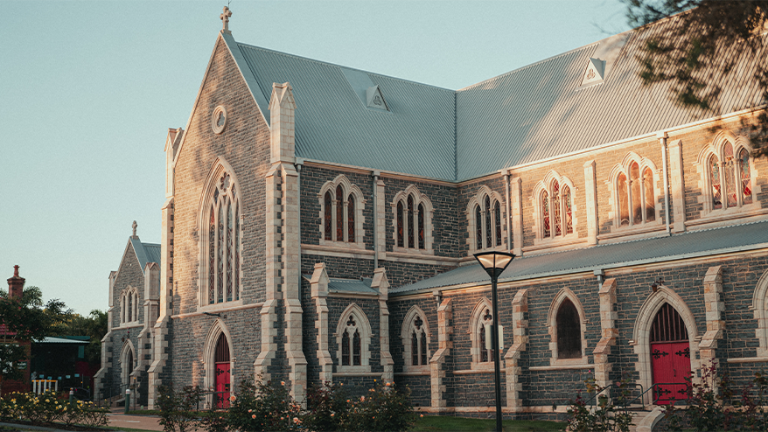
Places of Prayer Ritual and Liturgy

Slide 7

Places of Faith and Reason

Slide 8
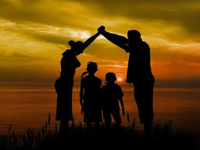
1.The Influence of Significant Others

Slide 9

2.Taking Responsibility for the Spirituality/Faith of others

Slide 10

3. Experience of a Spiritual/Faith Community

Slide 11

4. Life experiences that disorientate

Slide 12
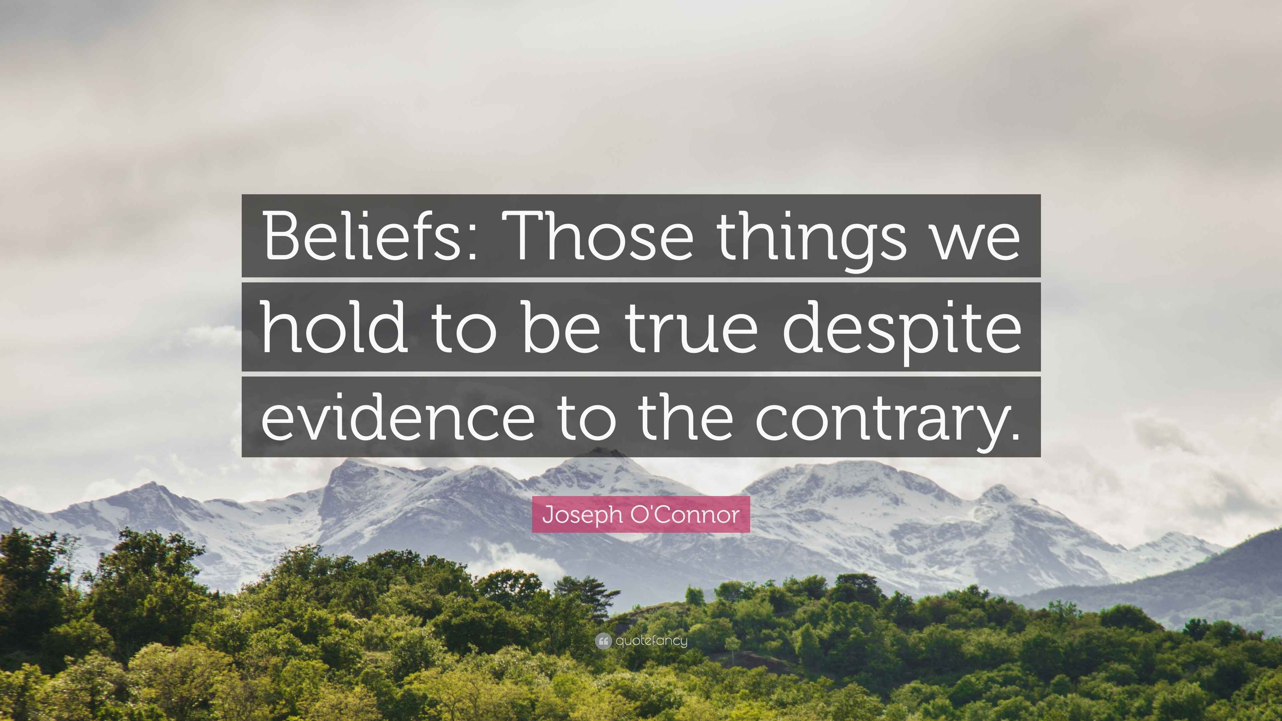
5. Exposure to Contrary Beliefs

Slide 13
‘The fact that in their own individual ways all members of the school community share this Christian vision, makes the school “Catholic”; principles of the gospel in this manner become the educational norms since the school then has them as its internal motivation and final goal.’

Slide 14
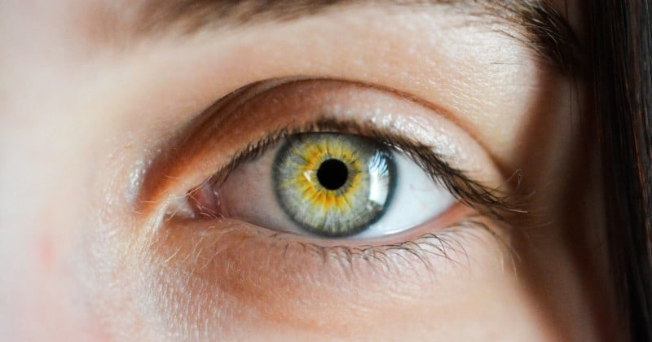
‘seeing which realises that human knowledge is not an individual possession but rather a common fund from which each may draw by believing with their senses, mind, and heart the experience and truth of others.

Slide 15

hearing that enables the making of a general judgement about the value of believing knowledge that is discovered by people other than themselves.

Slide 16
coming to know that they can make a specific judgement of value about believing a particular person, source, or authority whose truth interests them.

Slide 17
As a result of previous experiences or steps, there is the growth of knowing how to decide to believe a particular truth.

Slide 18
By making an act of belief, testifying to the truth that was discovered by another and becomes their truth.

Slide 19
As the school journey progresses, there are opportunities to believe or testify to learned truths that become the individual’s truth. At graduation, their Catholic education empowers students to choose from a diversity of abilities, skills, personal attitudes, and Christian values.

Slide 20
Places of Care and Attention to the Needs of Others

